Slide 1
ISCP2010
Symposium 1:
What is animal intelligence?
- Ability to generate novel adaptive behavior in humans and animals -
Tohru Moriyama, Masao Migita, Shin Maruyama, Nobuhiro Furuyama
Notes:
Today we would like to talk about our idea that animal intelligence is in their ability to generate novel adaptive behavior.

Slide 2
1. Timetable
Presentations
10:10-10:30 Tohru Moriyama (Pill bug)
10:30-10:50 Masao Migita (Starfish)
10:50-11:10 Shin Maruyama (Human)
Discussion and Questions
11:10-11:30 Nobuhiro Furuyama
Notes:
In this symposium, to give you a better understanding of our idea, three of our group,
Masao Migita, Shin Maruyama, and myself, Tohru Moriyama,
will each present.
Then, Nobuhiro Furuyama will review our research.
Finally, we will all invite your questions.

Slide 3
2. Problem
Problem-solving experiment: good method.
Animal that can solve problem also solved by human cannot always be called intelligent.
Notes:
First, when we try to understand animal intelligence, we encounter a conventional problem.
For example, to investigate animal intelligence, conducting a problem-solving experiment is a good method.
However, an animal that can solve a problem that can also be solved by a human being cannot always be called intelligent.

Slide 4
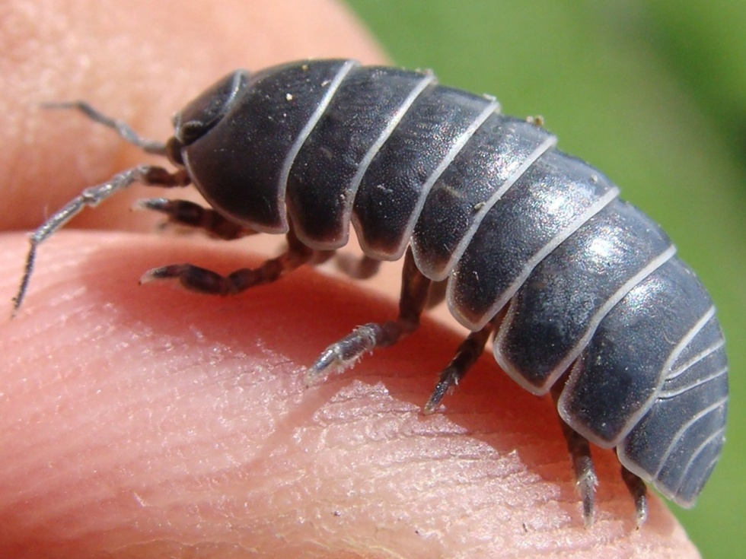
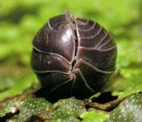
Pill bug,
Armadillidium vulgare,
Isopoda, Crustacea
Notes:
In this presentation, I introduce our approach to determining the intelligence of pill bugs.
Pill bugs, Armadilidium vulgare, belong to the Isopoda order of Crustaceans.
In Japan, these bugs are often found around the house.
Their bodies are about 1 cm, and they can roll up into a ball.

Slide 5
“Thinking”
Different mechanisms
“Mechanical process”
Pill bug
Notes:
Here is an example of a person and a pill bug encountering an obstacle and succeeding in detouring around that obstacle.
Here, one usually says that detouring by a person results from thinking.
In contrast, detouring by a pill bug results from a mechanical process.

Slide 6
Mechanical process and conventional adaptive behavior in pill bugs
Conventional adaptive behavior: Turn alternation (Kupfermann, Anim. Behav., 1966)
Fast
Slow
Slow
Fast
Mechanical process:
Bilaterally asymmetrical leg movement (BALM) (Hughes, Anim. Learn. Behav., 1985)
Notes:
For pill bugs, BALM, bilaterally asymmetrical leg movement, is a widely accepted hypothesis to explain their detouring behavior.
This simple mechanical process tries to compensate the asymmetrical leg movement occurring at the first turn and results in turn alternation.
Turn alternation can be considered an adaptive behavior because it corrects the deviations from linear movement in an escape situation.

Slide 7
4. Question
How can we determine intelligence in such mechanical animals?
Notes:
So, how can we determine intelligence in such mechanical animals?

Slide 8
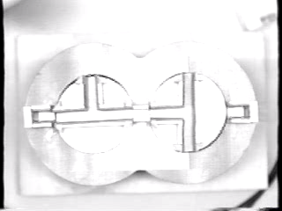
5. Answer
Setting unfamiliar situation
Notes:
Our answer is to set an unfamiliar situation.
In a previous experiment, pill bugs were placed into a consecutive T-maze.
At first, they repeated turn alternation dutifully.

Slide 9
6. Elicitation of novel adaptive behavior
Novel detouring
Sensing of wall’s texture
(Moriyama, Int’l. J. Comp. Psychol., 1999)
Notes:
However, after about two hundred turns, they stopped, searched the wall, and then climbed it to get outside the maze.
To describe the capacity for this kind of novel adaptive behavior to be elicited, we would like to suggest the word “intelligence”.

Slide 10
Mechanism of elicitation of novel adaptive behaviors
Stimuli sensed
Unfamiliar situation
Stimuli sensed
Choose
Ignore
Choose
Ignore
Leg movements
etc.
Leg movements
Wall’s texture
Others
etc.
Wall’s texture
Autonomous choice of stimuli
Pill bug
Pill bug
Notes:
How was climbing behavior elicited from the pill bugs?
Usually, in a single T-maze, pill bugs autonomously choose leg movements as stimuli and ignore other stimuli, for example, a wall’s texture, in order to maintain turn alternation.
However, in an unfamiliar consecutive T-maze, turn alternation doesn’t function as an adaptive behavior any more.
In this situation, they must search for a stimulus to elicit a new behavior so that they do not get stuck.
Then, because their choice of stimuli is essentially autonomous, they autonomously choose a stimulus that is usually ignored, such as the wall’s texture, which elicits climbing behavior.

Slide 11
Autonomous choice of stimuli:
common mechanism for “us”
Stimuli sensed
Capacity
Choose
Ignore
a, b, c, ・・・
α
β, γ, ・・・
Autonomous choice of stimuli
Human or animals
Notes:
This autonomous choice of stimuli is inevitable for not only animals but also human beings to elicit conventional adaptive behavior in normal situations. Humans and animals have the capacity to choose a tentative stimulus in unfamiliar situation.

Slide 12
In consecutive T-maze (unfamiliar situation)
Notes:
So, if a person and a pill bug are put into the consecutive T–maze...

Slide 13
Intelligent
in encountering stimuli eliciting novel adaptive behaviors
Common mechanism
Autonomous choice of stimuli
Notes:
The pill bug will climb the wall, and the person, for example, will autonomously choose the mechanical characteristic of the wall and push it down to get outside the maze.
In this situation, we can say that both human beings and pill bugs display equal intelligence.

Slide 14
Novel sensory organs in pill bugs:
artificial tubes attached to antennae
Tohru Moriyama
Young Researchers Empowerment Center, Shinshu University
Notes:
Next, I will introduce my recent research investigating whether pill bugs can use tubes attached to their antennae as tools to elicit novel adaptive behavior.

Slide 15
1. The antennae
flagellum
Notes:
The antennae are very important sensory organs for pill bugs to move because the bugs do not have proper vision.
Although they have two compound eyes on the head, they can perceive only different shades of light or dark.
The tip of an antenna is called a flagellum.
It bears many sensory setae.
Pill bugs scrutinize the surface in front of them by sweeping movements of the antennae.

Slide 16
Problem-solving situation
?
Notes:
In the field, pill bugs may encounter a cliff in their path, and it can be fatal for them to incorrectly estimate the depth of that cliff.
So, they must use their antennae to judge whether or not they can reach the bottom of the cliff safely, and then they decide to proceed or retreat.
In this sense, a cliff descent is an example of a problem-solving situation.

Slide 17
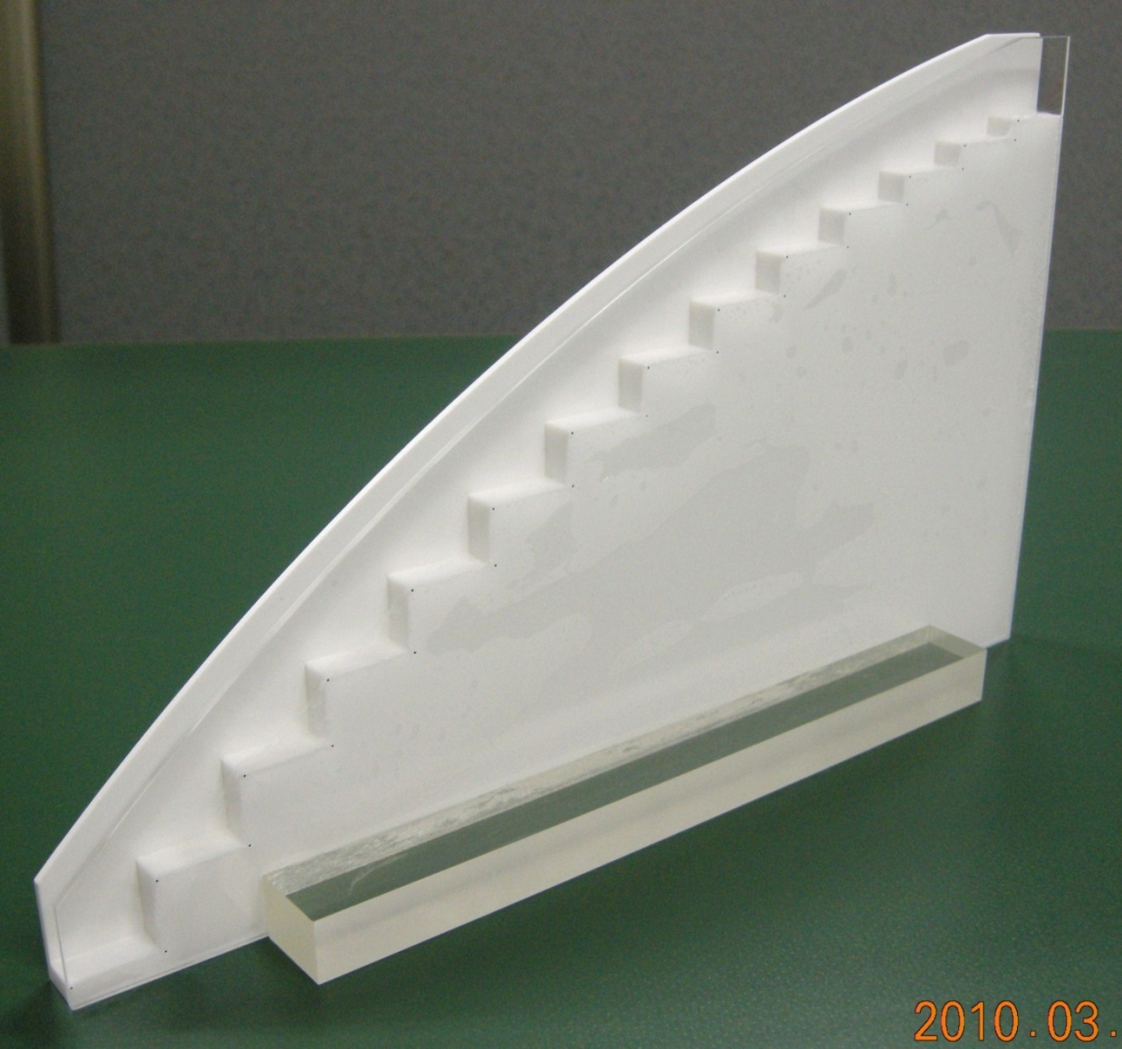
3. Stair descent experiment
Notes:
A stair descent experiment might be a good model of a cliff descent in the field.
In our experiment, each subject bug was placed on the top tread of a stairway consisting of 14 steps.
The riser height between the first and second steps at the top was 5 mm, and the height was consecutively increased by 1 mm for the rest of the steps.
The subjects were all highly motivated to move down the stairway in an escape situation.

Slide 18
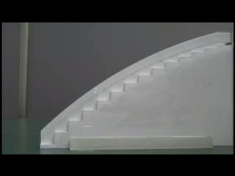

Slide 19
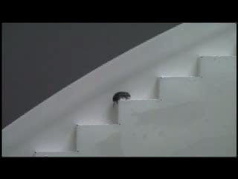

Slide 20
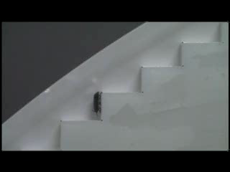

Slide 21
①
L (mm)
R_{m} (mm)
②
Maximum step
L: Body length
R_{m}: Maximum riser height
Notes:
Then, the maximum riser height, Rm, and the body length, L, for each subject were recorded.

Slide 22
4. Results for normal antennae
Notes:
This graph presents the relationship between body length and mean maximum riser height.
Where L is smaller than 10.5 mm, the value of the maximum riser height significantly increased and the plots fitted to a linear function, Rm=1.27 L.
In contrast, where L is larger than 10.5, the value of the maximum riser height significantly decreased.

Slide 23
L ≤ 10.5 mm
L
1.27L
Notes:
This result shows that the smaller pill bugs stretched their bodies in the challenge of descending to the next step at the maximum riser height.

Slide 24
L > 10.5 mm
Notes:
On the other hand, larger individuals seemed to decide to stop descending..

Slide 25
5. Unfamiliar situation
Teflon tube
clamped on
Short
Long
Can pill bugs use sense experienced
through the tube?
Notes:
Next, to elicit a novel adaptive behavior in this stair descent experiment, varying lengths of Teflon tubes were attached to the tips of the pill bug antennae for an unfamiliar situation.
Usually, when a foreign object attaches to their antennae, they remove it using the special antennal cleaning apparatus on the first walking leg.
However, as the Teflon tube was firmly clamped to their antennae, they couldn’t remove it using their legs.
In this situation, they were expected to use the unfamiliar sense from the tubes autonomously and a novel adaptive behavior would be elicited.
For a short-tube group, Teflon tubes approximately as long as the flagella were attached to the tips of the pill bug antennae.
For a long-tube group, tubes approx. twice as long as the flagella were used.

Slide 26
6. Results for antennae with tubes
Normal
Notes:
In the experiment, individuals whose body lengths were 10.2, 10.5, 10.8, 11.0 and 11.2 mm were used for the subjects.
The graph presents values of the mean maximum riser height of normal, short-tube and long-tube groups in each body-size group. In the 10.2 and 10.5 mm groups, the values in the short-tube and long-tube groups were significantly smaller that that of the normal group.
This result shows that the tubes inhibited the function of their antennae.
In the 10.8 mm group, the value in the short-tube group was significantly larger than that of the normal group.
In the 11.0 mm group, no significant difference was found among the groups.
Finally, in the 11.2 mm group, the value significantly increased as the length of the tube became longer.

Slide 27
7. Autonomous choice of stimuli through antennae
Stimuli sensed
Capacity
Choose
Ignore
Sense at tip of antennae
Sense from tubes
Autonomous choice of stimuli
Pill bug
Notes:
The result of the 11.2 mm group shows that they autonomously used sense experienced through the tubes and new cliff-descending behavior was elicited as a novel adaptive behavior.

Slide 28
8. Novel adaptive behavior
Normal
Descent
Short
Suspending descent
Artistic falling
Long
Notes:
In fact, when the bugs wore long tubes on their antennae and descended a very high riser, they seemed not to be descending but to be falling artistically.

Slide 29
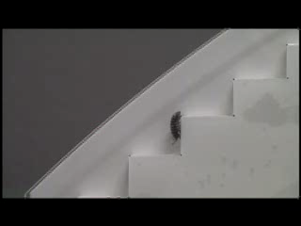

Slide 30
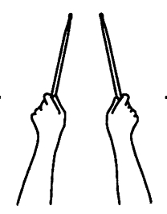
Sense from tubes
Sensation at tips of tubes?
In humans:
Sensation at tips of invisible tools (Yamamoto & Kitazawa, Nature, 2001)
Notes:
Additionally, the pill bugs of the 11.2 mm group might feel sensation through the tips of the tubes.
In human beings, sensation felt at the tips of invisible tools was reported in 2001.
In this way, we will continue to determine animal intelligence in terms of autonomous choice of stimuli and the elicitation of novel adaptive behavior.
Thank you.

Slide 31
Variant behaviors:
Turn alternation
Turn alternation
Variant
Variant
Variant
Variant
Variant
Variant

Slide 34
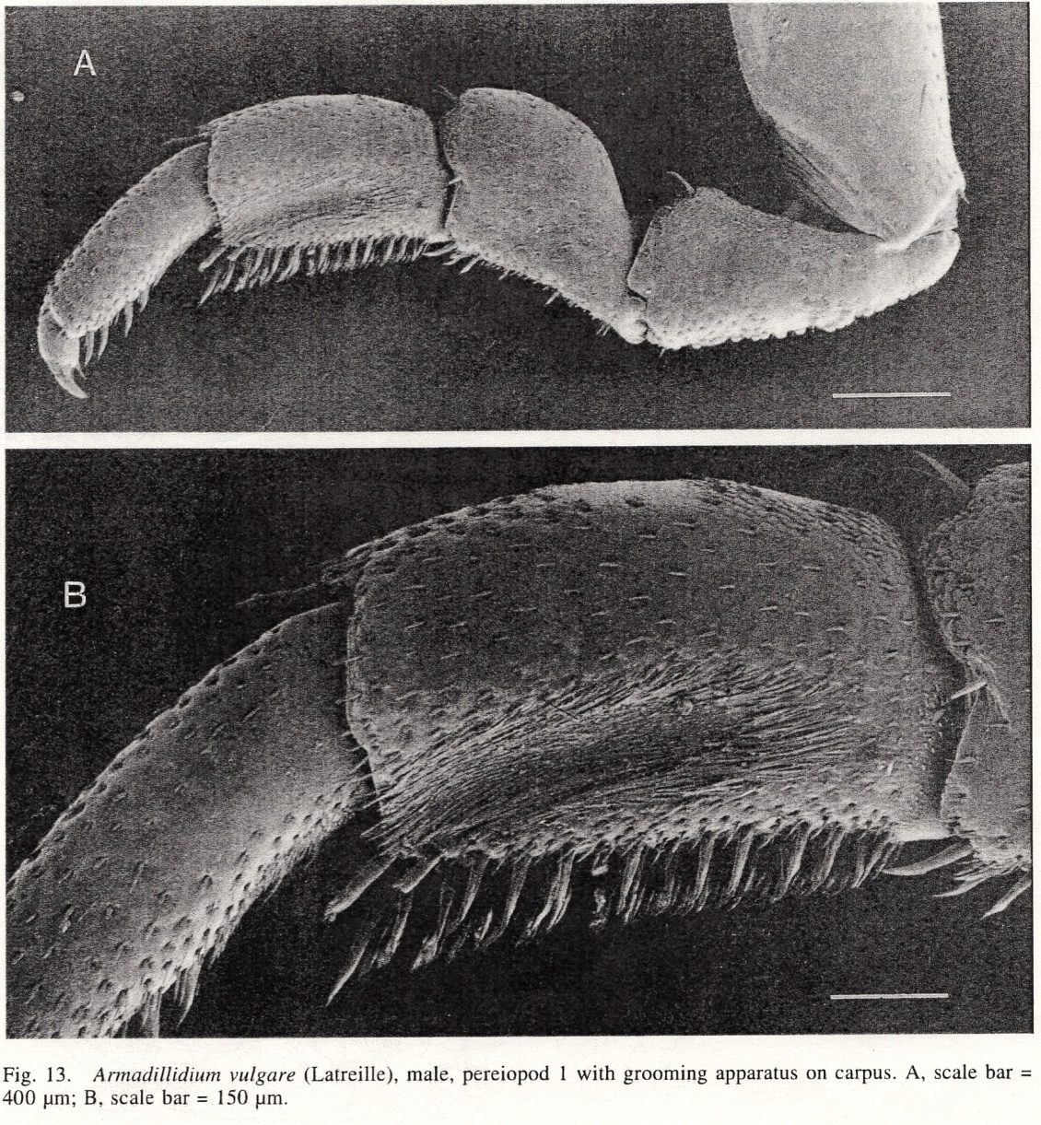
Antennal cleaning apparatus situated on first walking leg (Schmalfuss, J. Crust. Biol., 1998).

